Slide 1

Help social centers accurately identify patients having ptsd from anxiety
Audience: Non-technical social workers from counselling centers
Background: PTSD is a type of Anxiety problem, but not all with Anxiety has PTSD. Distinguishing factor is Trauma.
Aim: To provide model and incorporate into business process to accurately identify people with PTSD so that quick remedy can be provided.

Slide 2
Outline
Exploratory Data Analysis
Classification Modelling
Model Selection
Error Analysis
Highlight key findings and trends
Classification Metrics
Models:
Logistic Regression
MultinomialNB
Random Forest
Key findings and improvement
Production model Selection
Key insights

Slide 3
Exploratory Data Analysis
Data imported from subreddits r/PTSD and r/Anxiety
Pre-processing was done
Remove HTML
Remove all numbers and punctuations
Convert to lowercases
Removed Stopwords (common words)
Remove target leakage words such as trauma, PTSD, anxiety etc.

Slide 4
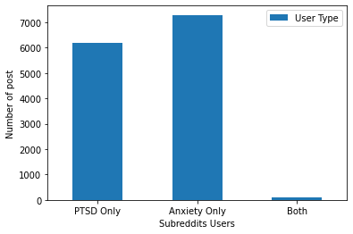
Visualizing differences in length of text
7289
6190
Visualizing Unique Users activity levels
93
Visualizing timeline across both subreddits VS No. of Posts
Total of 93 users in both subreddits
These users are ambiguous with no clear indication whether they do have PTSD or Anxiety

Slide 5
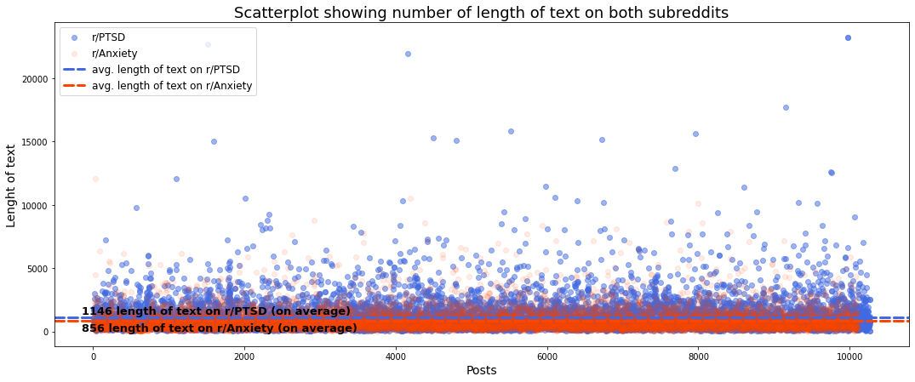
Visualizing differences in length of text
Visualizing Unique Users activity levels
Length of text,
Number of words
Higher in r/PTSD than in r/Anxiety.
Might indicate that people with PTSD have a lot more vent/experience/advice to face such issues
Visualizing timeline across both subreddits VS No. of Posts

Slide 6
Visualizing differences in length of text
Average no. of post per user
r/PTSD: 5
r/Anxiety: 7
Average no. of post per hour
r/PTSD: 1.23
r/Anxiety: 3.03
Generally..
We can infer that:
is likely more chance to find someone with Anxiety than having PTSD (source)
Users from r/Anxiety are more active by 2.5 times.
Visualizing Users activity levels
Visualizing timeline across both subreddits VS No. of Posts

Slide 7
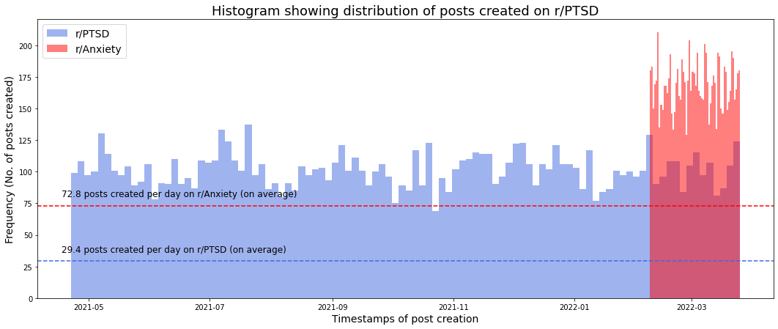
Visualizing differences in length of text
Cyclical trending with peaks in July and December
Visualizing Unique Users activity levels
Visualizing timeline across both subreddits VS No. of Posts
Cyclical Trend for number of post across months
Observed peaks in July and December

Slide 8
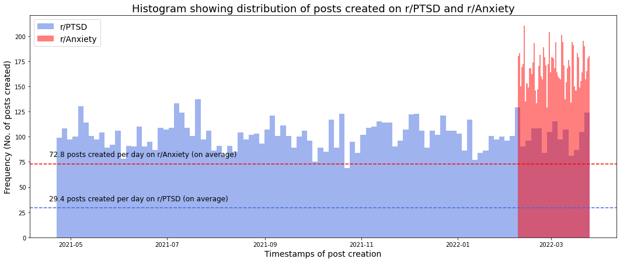
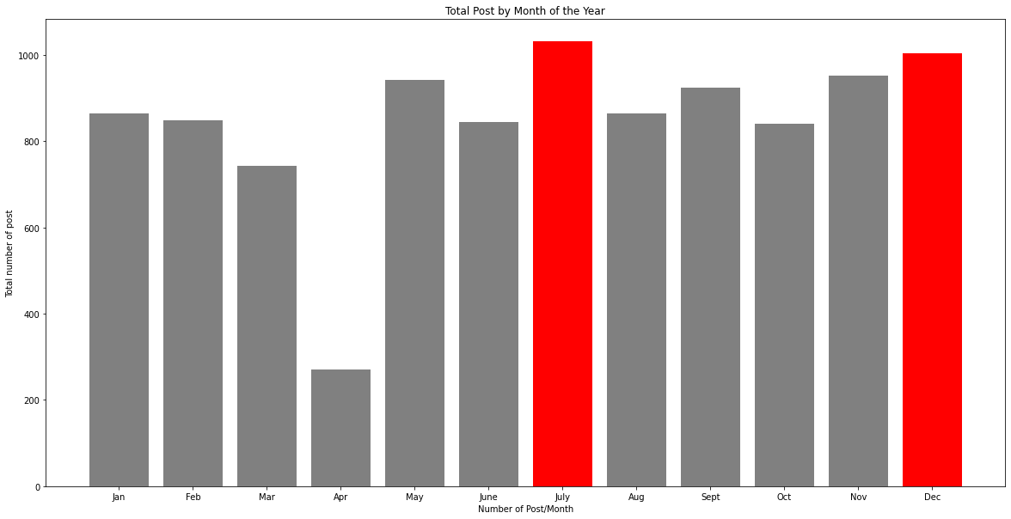
Cyclical trending with peaks in July and December
Visualizing differences in length of text
Visualizing Unique Users activity levels
Cyclical Trend for number of post across months
Observed peaks in July and December
This could be attributed to SAD, short form for Seasonal Affective Disorder, also known as a seasonal depression or the winter depression.
People tend to exhibit symptoms of anxiety when there is lesser sunlight (source)
Visualizing timeline across both subreddits VS No. of Posts

Slide 9
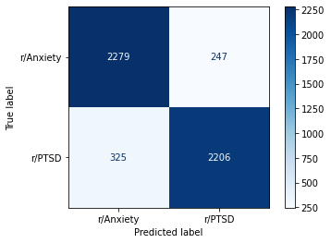

Classification Modelling
Classification metrics
Accuracy (For quick feedback on overall performance of the model making correct predictions – Hyperparameter Tuning)
Sensitivity (To be able to minimize missing out identifying users potentially having PTSD, as they could miss out on proper treatment, by the time they’ve been diagnosed, it might lead to permanent damage if untreated– Final Model Selection)
ROC_AUC (Measure of separability between classes – Final Model Selection)

Slide 10
Classification Modelling
Choice of Vectorizer
Chose TfidVec over CountVec based on Accuracy score and essentially it helps to retrieve words that are rare in some documents that might bring more predictive power.
Key observations
After using GridSearchCV, found that best parameters used is (1,1) indicating there is not much significance in 2-3 word combination that may help with predicting accurately
RandomForest is highly overfitted, hence unable to generalize to unseen data.
Although Logistic Regression may have the best accuracy, it tends to overfit as compared to MultinomialNB.

Slide 11
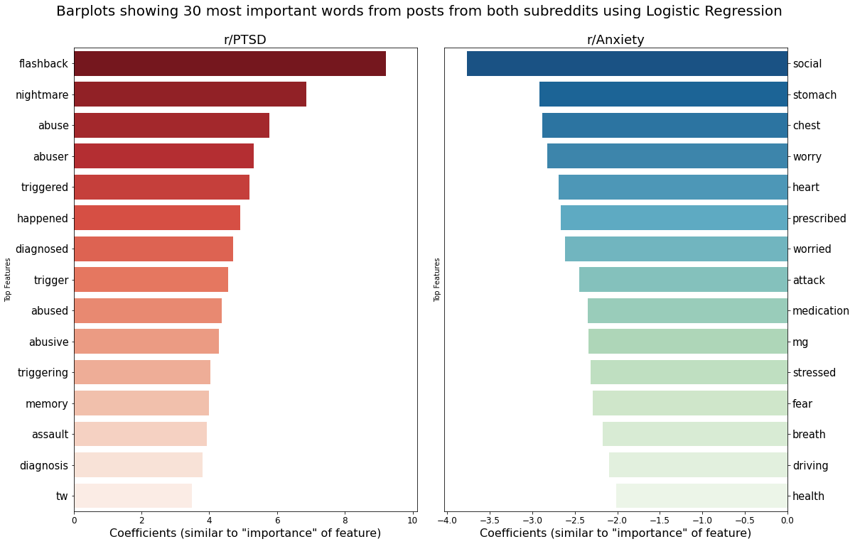
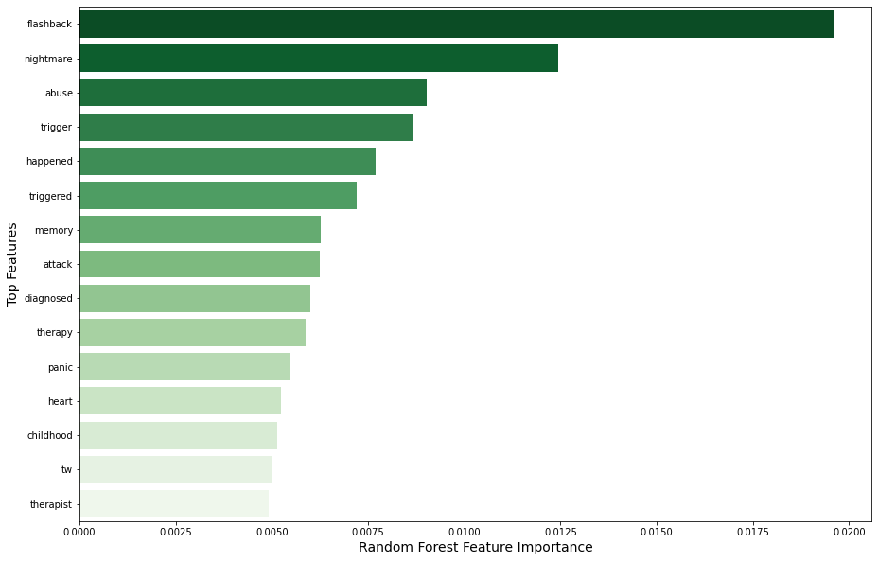
Error Analysis – Feature Importance
Logistic Regression
Random Forest
Generally, RandomForest and Logistic Regression has similar top few important features ranked the same way.
The features highlights words like flashbacks, nightmares and triggers that can serve as true symptoms of users suffering from PTSD

Slide 12
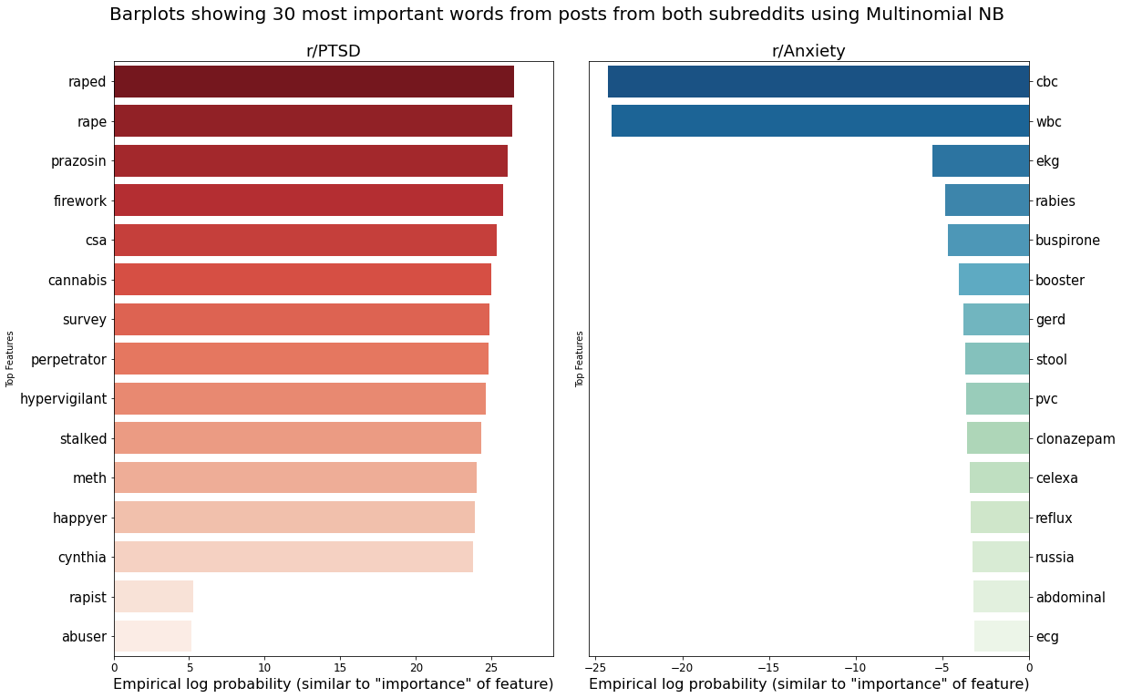
Error Analysis – Feature Importance
Logistic Regression
Multinomial NB
Top few features from MultinomialNB, you can find more words describing the Causes & Triggers of PTSD more like rape, “csa” which stands for childhood sexual abuse, stalked
and firework

Slide 13
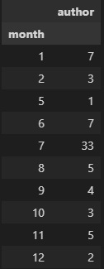
Error Analysis – Feature Importance
Upon investigating the main dataset, users are mainly expressing
Agony
Scared
Triggered thinking it was incoming mortars and rockets.
Multinomial NB
Number of post in a month
All 70 post about fireworks are from r/PTSD. Based on source, people with past trauma related to sound are impacted worse by loud explosion, reminiscing imminent threat and may activate the brains’ threat detectors.

Slide 14
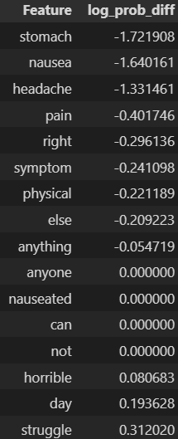
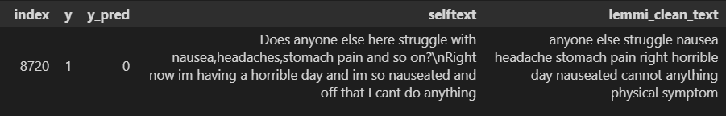
Common mis-classifier
False Negative
Predict : Anxiety, Actual: PTSD
Missing strong predictive words
May contain strong words that also describes users in r/Anxiety

Slide 15
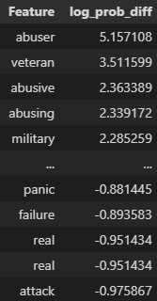
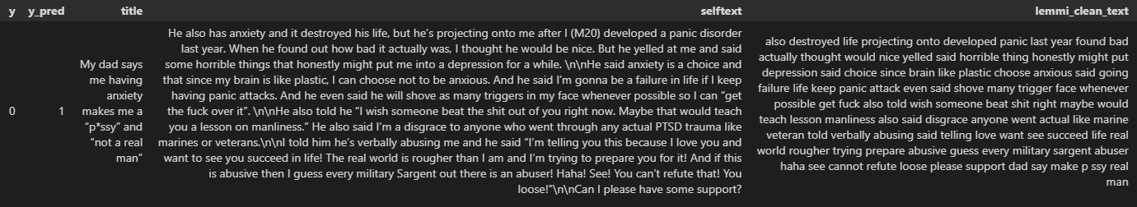
Common mis-classifier
False Positive
Predicted: PTSD, Actual: Anxiety
Contains strong features of positive coefficients
However, context was about the father who has PTSD.

Slide 16
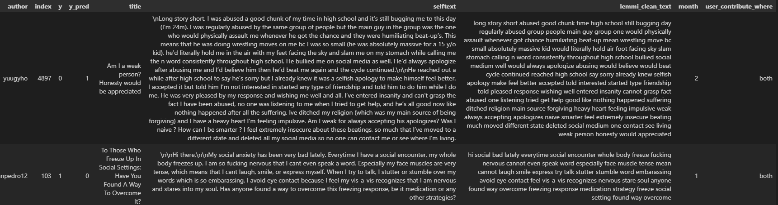
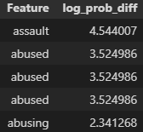
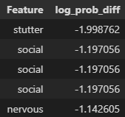
Common mis-classifier – Users in both subreddits
False Positive
Predicted: PTSD, Actual: Anxiety
Contains strong features towards positive class like abused, assaulted.
User actually posted in Anxiety.
False Negative
Predict : Anxiety, Actual: PTSD
Lacks strong predictive words from positive class
User actually posted in PTSD.

Slide 17
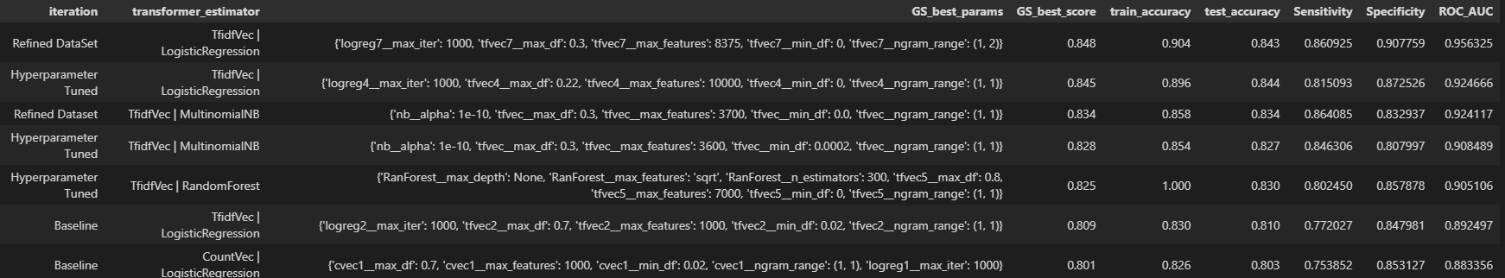
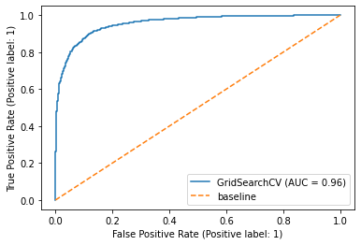
Model Selection
Accuracy improved by 5.8%
Logistic regression
For its best accuracy and sensitivity score.
ROC Score
- The better the score, the better it is at distinguishing patients with PTSD and Anxiety.

Slide 18

Conclusion & Recommendations
Problem statement is to provide social service a helping hand in accurately identifying people having PTSD from Anxiety
Phase 1: Used subreddit to obtain sufficient documents to start off a model.
Phase 2: Hyperparameter tuned and refined dataset to improve model
Still have room for improvement to increase metrics like ROC_AUC , Accuracy and Sensitivity
Phase 3: Implement to social services incorporate in
Entry forums for new patients who wishes to go for counselling (to collect more data)
Used for complementary support platform (rather than a main system) to help prompt social workers early.
Main idea is to continue collecting real time context because with professional feedback on jargons used and proper classification, it should gain more accuracy and better predicting power while already implementing this to help classify people having PTSD with considerable accuracy.
Keeping in mind having high peaks of the number of post in June and Dec, you may consider running a campaign to beef up support for people and use these high peaks as a matrix in the following years to track the effectiveness of the campaigns.

